Slide 1
Introduction to Statistics for Ecology and Evolutionary Biology Binomial Regression Week 13 20 April 2020

Slide 2
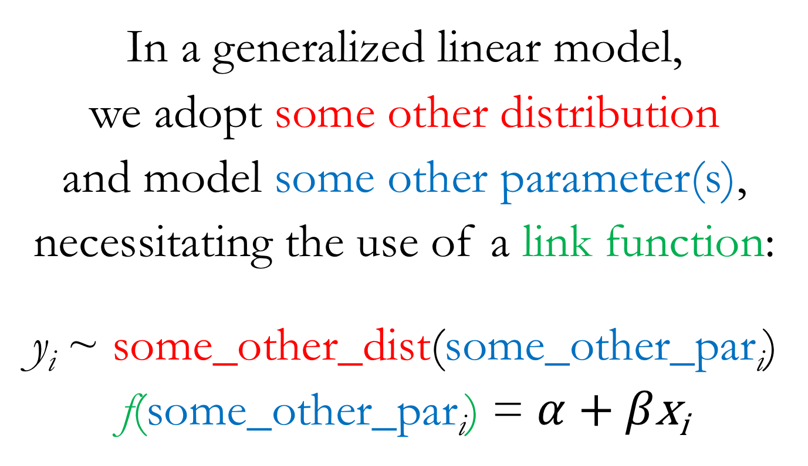
From Linear Models to Generalized Linear Models (GLMs)
In a generalized linear model,
we adopt some other distribution
and model some other parameter(s),
necessitating the use of a link function:
y_{i} ~ some_other_dist(some_other_par$\text{i}$)
f(some_other_par$\text{i}$) = $α$ + $β\text{x}\text{i}$
Notes:
Modeling of different parameters will usually necessitate the use of a link function
This is because the new parameters we’ll be interested in modeling are typically not unbounded in both directions
Conveniently, the target of most of our modeling effort so far, the mean parameter in a Gaussian distribution, has been unbounded in both directions, making it easier for us up until this point

Slide 3
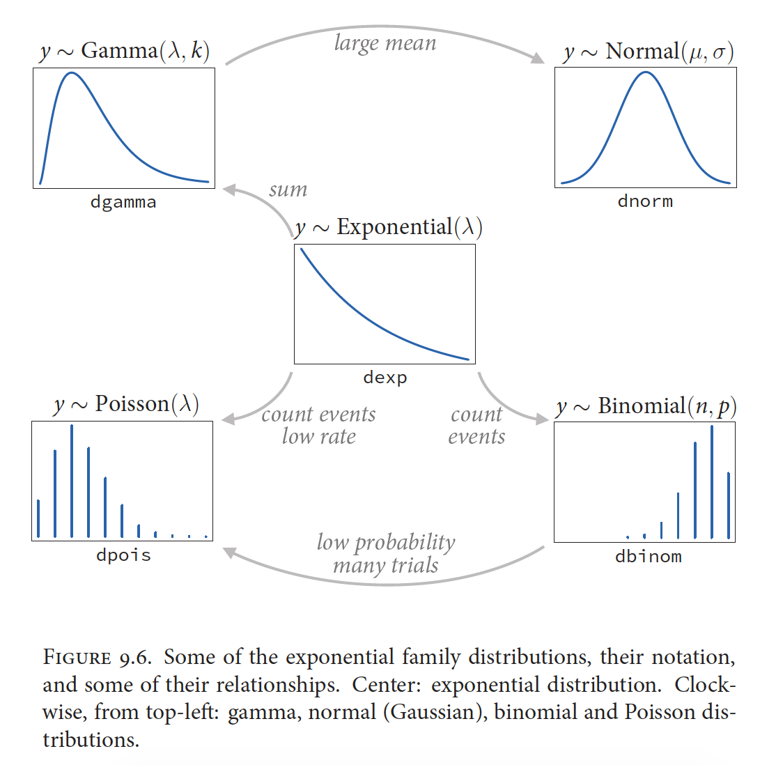
McElreath 2016, Statistical Rethinking

Slide 4
Binomial Distribution
A discrete probability distribution with two parameters:
n = number of trials, p = probability of success
Outcome is the number of successes (x) in n trials with probability of success p
The probability mass function in R:
dbinom(x, size, prob)
Where x = the number of successes, size = n, prob = p
The random generation function in R:
rbinom(n, size, prob)
Where n = the number of observations to generate, size = n, prob = p
Notes:
Note the confusion that might arise with the “probability of success” parameter here in the binomial distribution
This is a parameter we’re trying to estimate
So a posterior distribution for the probability of success parameter (p) shows us the relative probability of different probability of success values
This is all rather meta, so take some time to let it sink in

Slide 5
Binomial Distribution: Ecological Examples
Infection or disease (yes/no)
Survival (survived/died)
Occurrence (occupied/unoccupied)
Notes:
Data that are commonly expressed as proportions are often modeled as binomial events
Any decision or outcome that can be dichotomized could be modeled using the binomial
http://capitalnaturalist.blogspot.com/2017/10/mangy-foxes.html

Slide 6
Binomial Distribution: Visualized
Notes:
These are the probability mass functions for three different binomial distributions
https://en.wikipedia.org/wiki/Binomial_distribution#/media/File:Binomial_distribution_pmf.svg

Slide 7
Probability
p
Bounds: 0 to 1

Slide 8
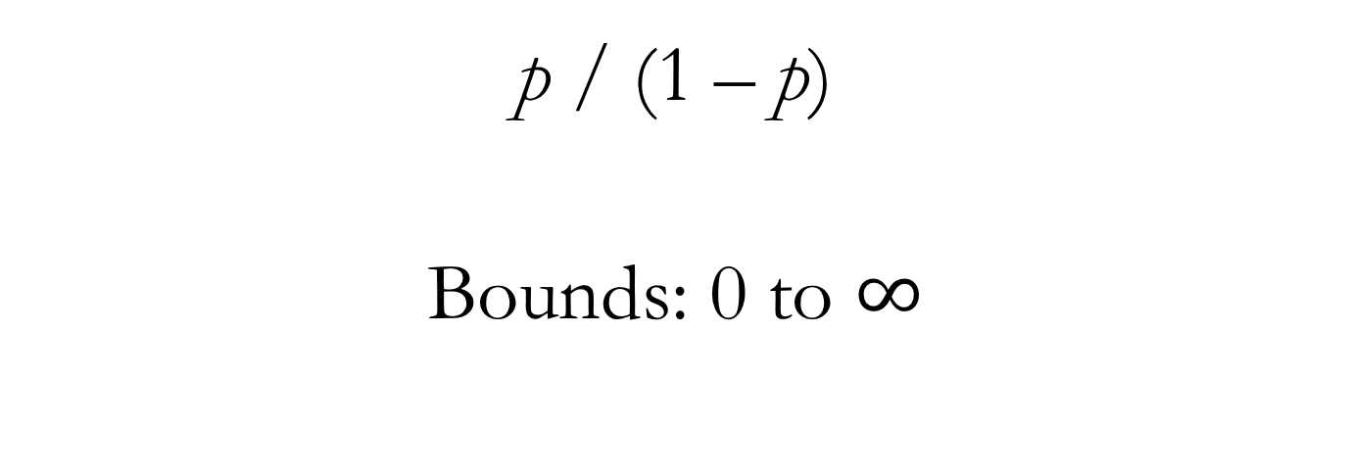
Odds
p / (1 – p)
Bounds: 0 to $∞$

Slide 9
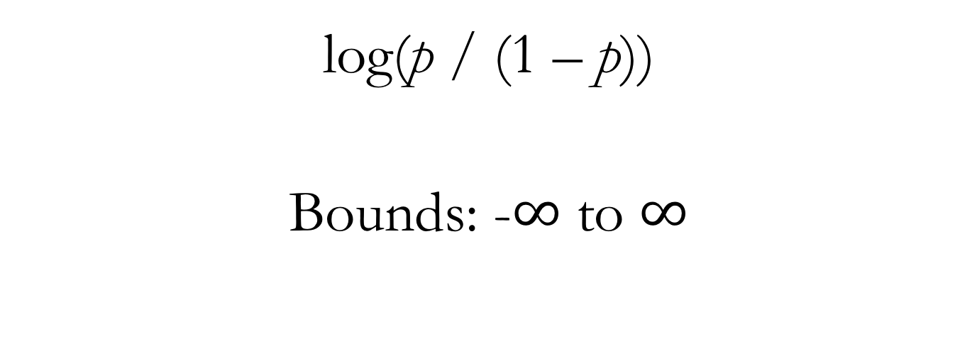
Log-odds (aka the Logit Function)
log(p / (1 – p))
Bounds: -$∞$ to $∞$

Slide 10
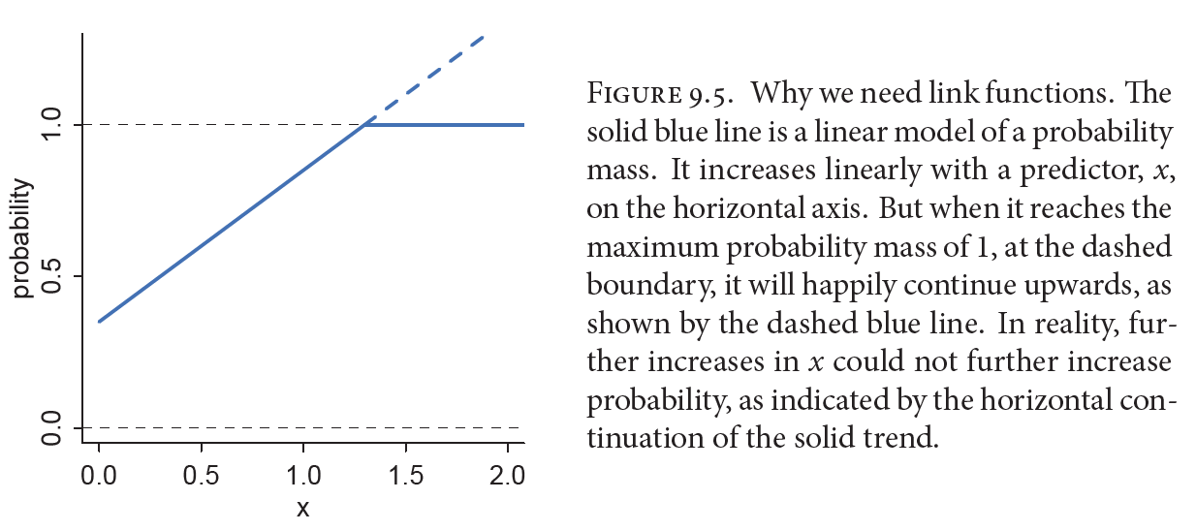
The Necessity of Link Functions
McElreath 2016, Statistical Rethinking
Notes:
“A link function’s job is to map the linear space of a model…onto the non-linear space of a parameter like...So f is chosen with that goal in mind.”

Slide 11
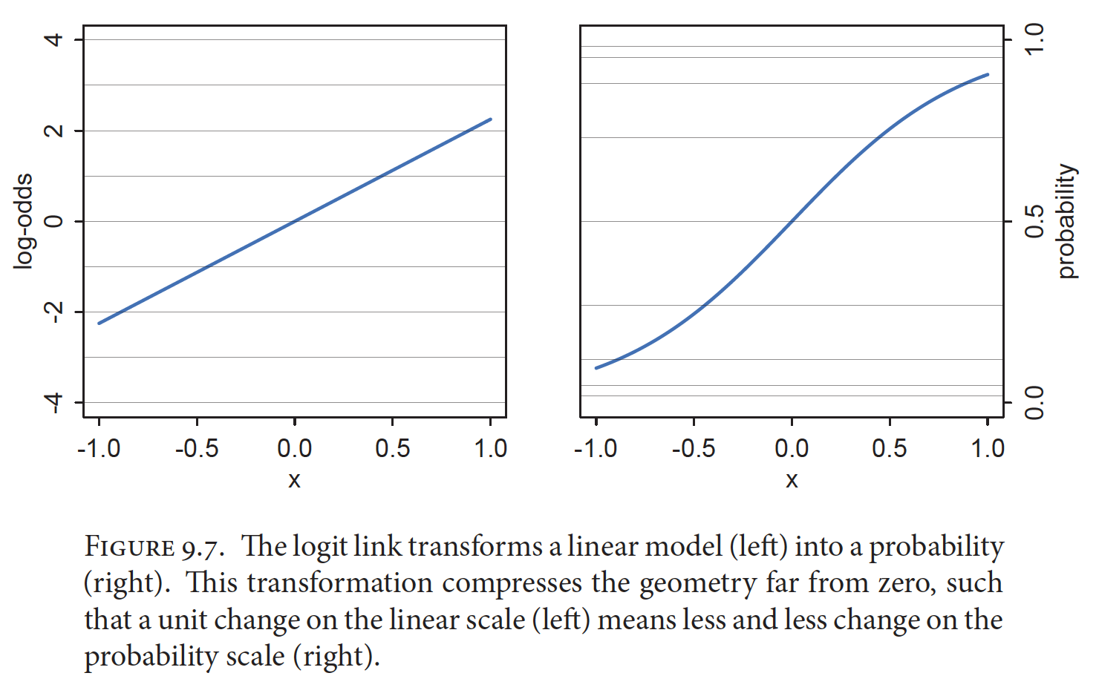
Logit Link for Binomial GLMs
McElreath 2016, Statistical Rethinking
Notes:
“The logit link maps a parameter that is defined as a probability mass, and therefore constrained to lie between zero and one, onto a linear model that can take on any real value.”
The inverse of the logit function is the logistic function (also sometimes called the inverse-logit)
Show lecture code relating to probabilities, odds, and log-odds

Slide 12

Binomial GLM
y_{i} ~ Binomial(n, p_{i})
logit(p_{i}) = $α$ + $β\text{x}\text{i}$

Slide 13
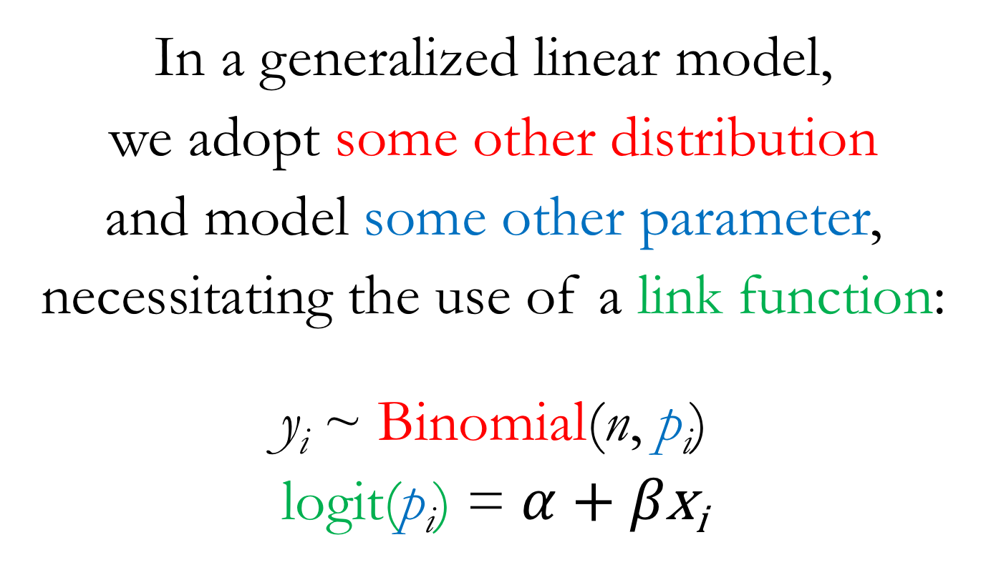
Binomial GLM
In a generalized linear model,
we adopt some other distribution
and model some other parameter,
necessitating the use of a link function:
y_{i} ~ Binomial(n, p_{i})
logit(p_{i}) = $α$ + $β\text{x}\text{i}$

Slide 14
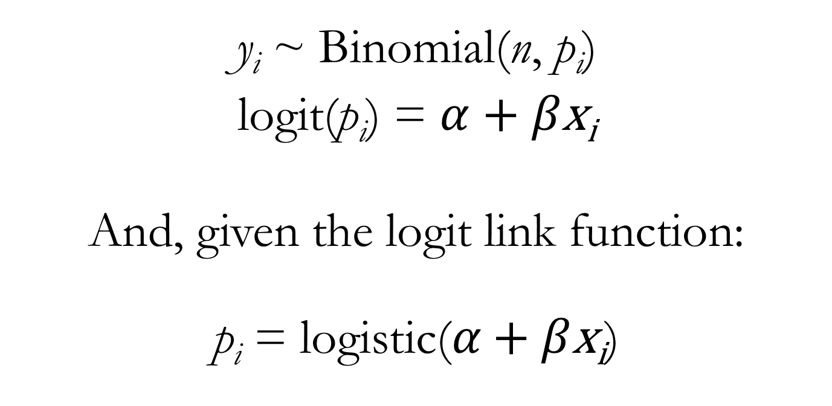
Binomial GLM
y_{i} ~ Binomial(n, p_{i})
logit(p_{i}) = $α$ + $β\text{x}\text{i}$
And, given the logit link function:
$\text{p}\text{i}\text{ =} \text{logi}\text{s}\text{t}\text{ic}\text{(}α\text{ + }β\text{x}\text{i}$)
Notes:
So you can think about this one of two ways:
The linear portion of our model is used to model the logit-transformed parameter value (which puts it on the unbounded scale)
I.e.: “The logit link maps a parameter that is defined as a probability mass, and therefore constrained to lie between zero and one, onto a linear model that can take on any real value.”
OR: the raw parameter value is defined by applying the inverse link function (the logistic) to the linear portion of the model (forcing the linear portion of the model to take on values between 0 and 1)

Slide 15
Two Flavors of Binomial GLM
Logistic regression commonly refers to the situation when binomial data are organized into single-trial cases
So the number of trials (n) for every observation will simply be 1
And the number of successes (y) can only be 0 or 1
Aggregated binomial regression refers to the situation when binomial data are aggregated for all observations having the same covariate values
So the number of trials (n) for every “observation” may differ
And the number of successes (y) can range from 0 to n

Slide 16
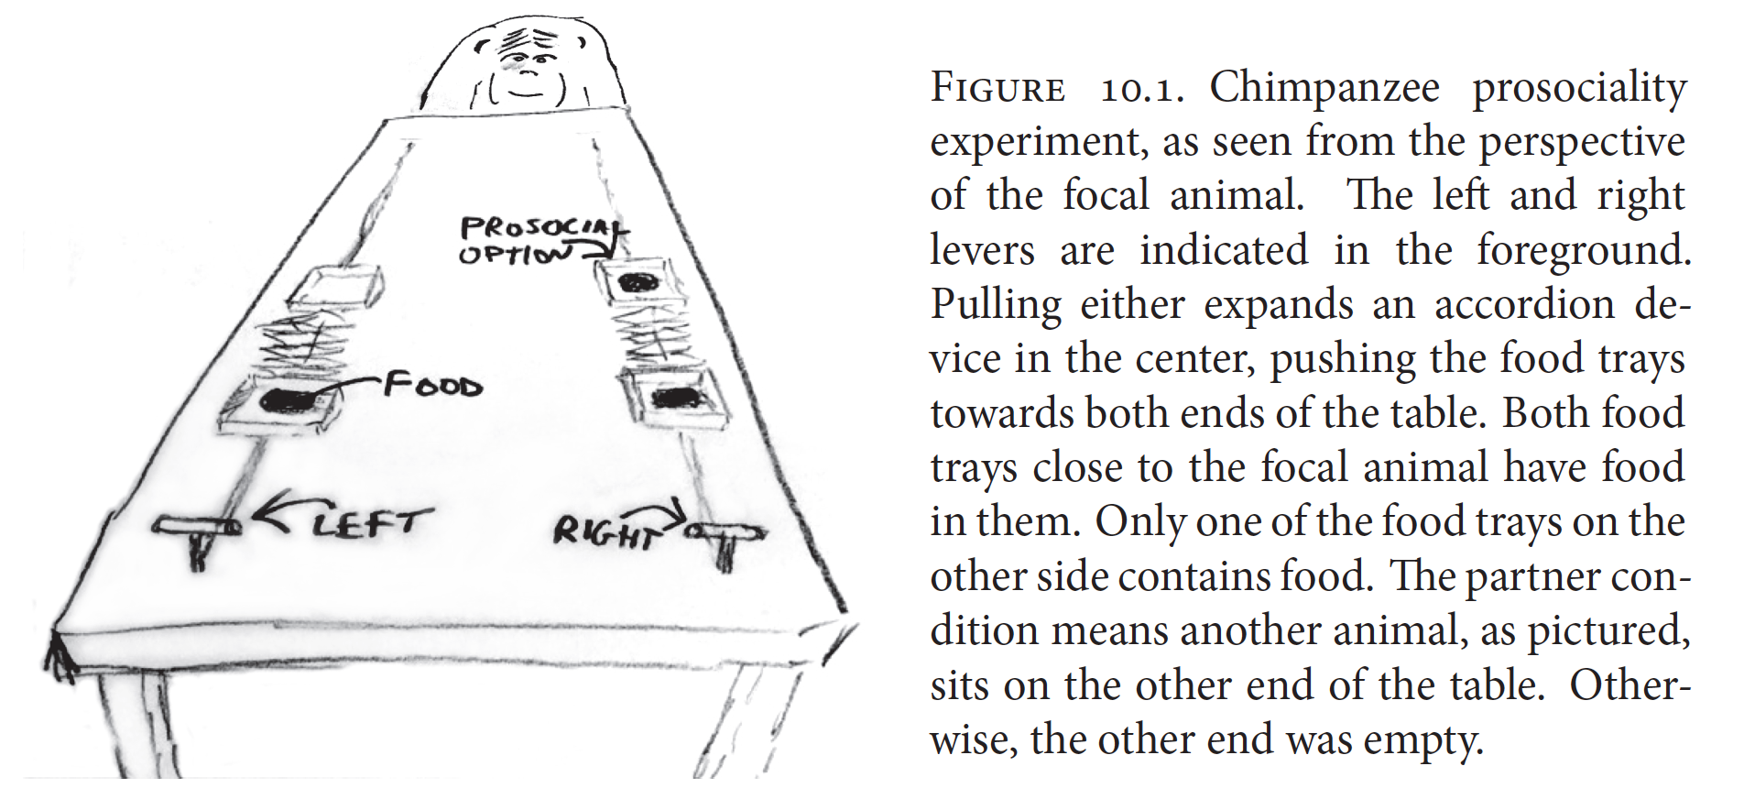
Prosocial Chimpanzees
McElreath 2016, Statistical Rethinking
Notes:
Two experimental variables of interest: the side of the table on which the prosocial option appeared and partner vs. control condition

Slide 17
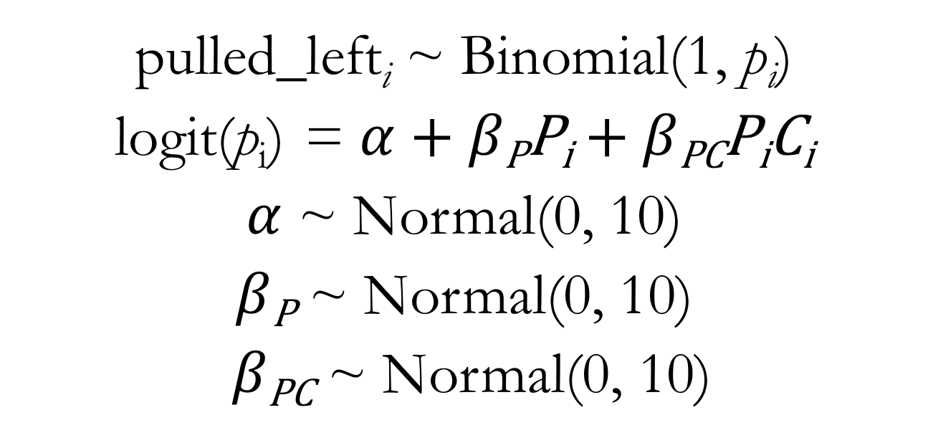
Binomial GLM for Chimpanzee Prosociality Predictors: Prosocial on Left and Interaction between Prosocial on Left and Condition
pulled_left_{i} ~ Binomial(1, $\text{p}\text{i}$)
logit(p_{i}) = $α$ + $β\text{P}\text{P}\text{i}$ + $β\text{PC}\text{P}\text{i}\text{C}\text{i}$
$α$ ~ Normal(0, 10)
$β\text{P}$ ~ Normal(0, 10)
$β\text{PC}$ ~ Normal(0, 10)
Notes:
Note that this model does not have a main effect of condition
Show lecture code of chimpanzee models

Slide 18
Many Shades of Snow Geese
White Morph
Blue Morph
Notes:
Show lecture code of snow goose models
https://www.allaboutbirds.org/guide/Snow_Goose/media-browser/59939451
https://www.allaboutbirds.org/guide/Snow_Goose/media-browser/78204831

